Slide 1


Cannabis Use among Patients in Primary Care: Findings from a Screening Program Implemented in a Large Urban Health System
Lillian Gelberg, MD, MSPH, FAAFP
Marjan Javanbakht, MPH, PhD
Presentation To: 19th INEBRIA Conference, Greensboro NC
September 28, 2023

Slide 2

objectives
Describe implementation of electronic health record (EHR) administered cannabis screening among adult primary care patients in a large urban health system
Describe the epidemiology of cannabis use among a clinical population, including:
  Prevalence of cannabis use, including medical use
  Cannabis use disorder, and co-use with tobacco
  Reasons for cannabis use including symptoms managed with cannabis, frequency of use, mode of use, and association with sociodemographic factors and clinical conditions

Slide 3

Background
Cannabis is legal in the United States:
  Recreational use: 23 states & Washington D.C.
  Medical use: 38 states & Washington D.C.
Routine screening for cannabis use is not standard practice in healthcare settings
  Especially lacking is screening for medical use of cannabis
We implemented a first of its kind, universal cannabis and medical cannabis screening in a large healthcare system using the EHR patient portal
  Screening results were further strengthened by linkages with other EHR data including medical outcomes

Slide 4


Methods –
EHR Screening approval process
2 Year process to receive approval from health system leadership, including primary care and physician informatics committees – took this long even in California where cannabis use is legal!
Conducted pilot testing in a small number of clinics and full launch across 90+ adult primary care clinics in January of 2021
Data are from January 2021 through May 2023
4

Slide 5
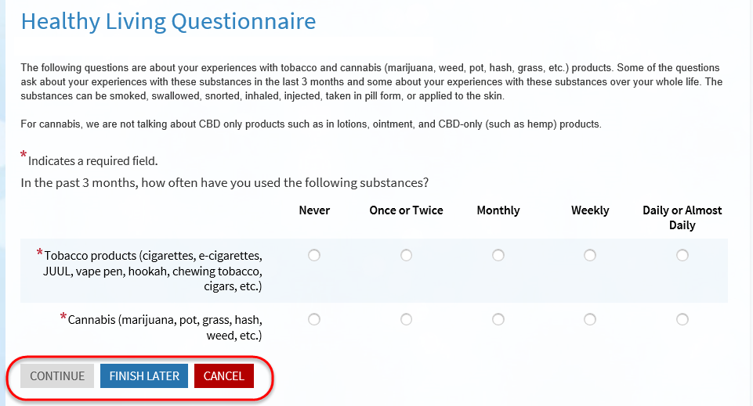
Methods – Screening tool
The Tobacco and Cannabis Questionnaire (TCQ) is sent to all Primary Care Adult patients with Annual Wellness and New patient visits (including gyn and geriatrics)
TCQ screening is automated and sent to patients pre-visit via the EHR (Epic) patient portal (MyChart) to self-administer
  Most patients will only have to complete 3 questions
Notes:
3 questions max
Validated scale to categorize patients to low-moderate or high use
Readd to full talk:
Tobacco use questions include:
e-cigarettes, hookah, chewing tobacco, 2nd hand smoke exposure
Cannabis use qs:
, 2nd hand smoke exposure

Slide 6
Methods – Screening items
Cannabis use questions include:
  WHO-ASSIST (levels of cannabis use), mode(s) of use, frequency and reasons for use, medical vs non-medical use
ASSIST scoring mapped to DSM-4
  Cut-point for risky cannabis use was increased from ASSIST 4 to ASSIST 8 (comparable to adaptation for alcohol use)
  Adapted cut-point provides a more meaningful clinically actionable set point
Responses are categorized into risk for cannabis use disorder including:
  No use (ASSIST 0)
  Low use (ASSIST 1-7)
  Moderate use (ASSIST 8-26)
  High Use (27+)
Providers receive advisory message for patients’ screening results with links to provider support tools in the EHR (‘SmartSet’)
Notes:
This is an example of what the provider can see.

Slide 7
Results – demographics
175,734 patients were screened for cannabis use (January 2021-May 2023)
Median age: 47 years (IQR: 35-61)
58% female
Race/ethnicity
  16% Asian
  14% Hispanic/Latinx
  4% Black/African American
  3% MENA
  32% White/Caucasian
  31% Other

Slide 8
Prevalence of Cannabis use and CUD
Among adult primary care patients, past 3 months
17% Cannabis Use
  Among cannabis users, 35% screened positive for CUD

Slide 9
Medical Cannabis use
Reasons for cannabis use, past 3 months
  16% medical only
  53% non-medical only
  31% both medical and non-medical
Used cannabis to manage a ‘symptom’
  76% of all cannabis users
  However, among those reporting strictly non-medical use, 58% reported using cannabis to manage a ‘symptom’

Slide 10
Symptoms managed by cannabis, past 3 months
Median number of symptoms was 2 (IQR: 1-4)

Slide 11
Results – Mode of use
Inhalation (e.g. smoke, vape, dab) and ingestion (e.g. eat, drink) equally common modes of use
Sex differential in mode of use
  Higher prevalence of any mode of ingestion and skin application among females as compared to males (p<.01)

Slide 12
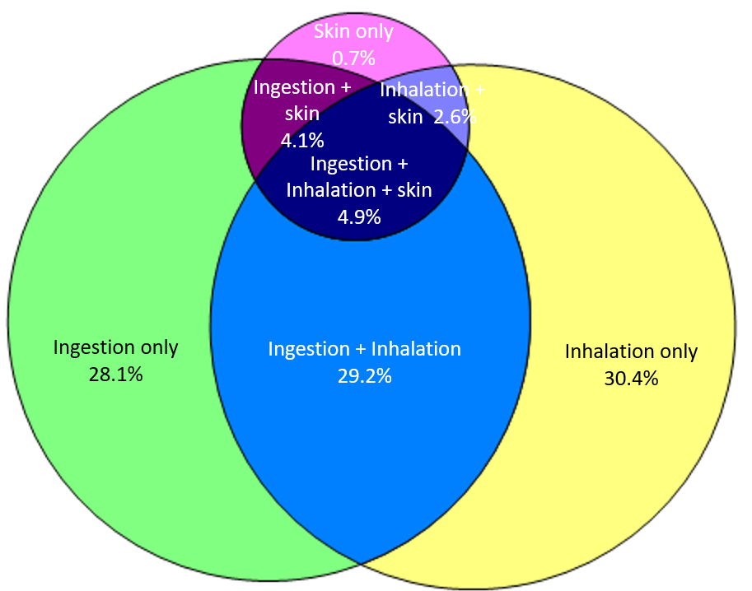
Results – Mode of use
42% of patients who reported cannabis use in the past 3 months, reported multiple modes of use
  29% ingestion + inhalation
  5% ingestion + inhalation + skin application

Slide 13
Results – Correlates of cannabis use, past 3 months
Cannabis Use & CUD more common among younger, males, least common among Asians
Notes:
These are row precents

Slide 14
Results – Factors associated with Cannabis use
Based on multivariable analysis:
Reduced odds of cannabis use among women as compared to men
Increased odds of cannabis use among those in the younger age groups with 18-29 year olds having nearly 6x greater odds of cannabis use as compared to those 60 and older
Compared to Whites, Asians, Latinos, MENA less likely to use cannabis
For every decile increase in neighborhood disadvantage (ADI rank) there was a 20% decreased odds of cannabis use
Table 3. Multivariable logistic regression analysis of factors associated with cannabis use (past 3 months)
among patients receiving care at a large urban health system, January 2021-May 2023 (n=175,734)
 | Adjusted OR (95% CI)^ |  |  | Adjusted OR (95% CI)
Female (vs. Male) | 0.6 | (0.6 - 0.7) | Asian (vs. white) | 0.5 | (0.4 - 0.5)
 |  |  | Black/African (vs. white) | 1.0 | (0.4 - 1.1)
Age 18-29 (vs. ≥ 60) | 5.6 | (5.4 - 5.9) | Hispanic/Latinx (vs. white) | 0.7 | (0.7 - 0.8)
Age 30-39 (vs. ≥ 60) | 3.6 | (3.5 - 3.8) | MENA (vs. white) | 0.6 | (0.5 - 0.7)
Age 40-49 (vs. ≥ 60) | 2.4 | (2.3 - 2.5) | Other Race (vs. white) | 1.1 | (1.0 - 1.1)
Age 50-59 (vs. ≥ 60) | 1.6 | (1.5 -1.7)
 |  |  | ADI state rank* | 0.8 | (0.7 - 0.9)
Abbreviations: OR=Odds Ratio; CI=Confidence Interval; MENA=Middle Eastern and North African; ADI=Area Deprivation Index
*estimated for every decile change
*model adjusts for sex, age, race/ethnicity, and ADI state rank
Notes:
Interpretation: in multivariable analyses, even after adjusting for other factors
Reduced odds of cannabis use among women as compared to men
Increased odds of cannabis use among those in the younger age groups with 18-29 year olds having nearly 6x greater odds of cannabis use as compared to those 60 and older
Interestingly, for every decile increase in neighborhood disadvantage there was a 20% decreased odds in cannabis use – meaning as neighborhood disadvantage increased, cannabis use decreased.

Slide 15
Summary of Findings and recommendations
Cannabis use is common among adult primary care patients (17%)
  => Routine screening is critical
Among cannabis users, one-third are at moderate-high risk for cannabis use disorder.
  To facilitate SBIRT, we developed a Smartset of provider support tools
    PCP uptake was low
  Strategies needed to help providers and patients to facilitate BIRT in large health care systems
Notes:
Smartset is hardly used

Slide 16
Summary of Findings and recommendations
Multiple modes of use are common with ingestion being as common as inhalation
  PCP Brief Intervention
    Can counsel on inhalation risks (e.g., among patients with asthma, COPD)
    Can counsel on safe storage of edibles to prevent OD among children and pets
Medical Cannabis use is common!
  => PCPs should not miss opportunity to identify and address cannabis users’ mental health symptoms, sleep, and pain
Notes:
Most (3/4s) of patients who use cannabis use it to manage their symptoms
=> providers should not miss opportunity to identify and address cannabis users’ mental health symptoms, sleep, and pain
Cannabis use, medical cannabis use, symptoms using it for
Provide the latest evidence regarding benefits, harms, alternatives
Providers are provided a script within the Smartset with brief advice tips for advising patients, e.g., on safely storing cannabis products to prevent accidental overdose of others such as children and pets.

Slide 17
UCLA QUIT-TC Study team
Lillian Gelberg, MD, MSPH, FAAFP (mPI)
Marjan Javanbakht, PhD (mPI)
Steven Shoptaw, PhD (co-I)
Whitney Akabike MSPH (Project Director)
Lawrence Dardick, MD (Physician Informaticist)
Clara Lin, MD (Physician Informaticist)
Michael Shin, PhD (Geography)
David Gomez (Epic Clinical Content Analyst)
UCLA Department of Family Medicine
This work was supported by the University of California Tobacco-Related Disease Research Program (TRDRP, #T29IR0277)

Slide 18

contact
If you have questions please contact us
Lillian Gelberg, MD, MSPH, Principal Investigator
lgelberg@mednet.ucla.edu
Marjan Javanbakht, PhD, Co-Principal Investigator
javan@g.ucla.edu
Lawrence Dardick MD, UCLA Physician Informaticist
ldardick@mednet.ucla.edu
Whitney Akabike, PMP, MSPH, Project Director
wakabike@mednet.ucla.edu

Slide 19
Additional slides

Slide 20

Implementation: Lessons Learned

Slide 21
Implementation of the Tobacco and Cannabis Questionnaire (TCQ)
How did we get approval from UCLA Primary Care Leadership?
  No burden to clinic staff or disruption to clinic workflow
    Automated, pre-visit screen, via EHR patient portal
  Reduced stigma of reporting of cannabis use
    Patient self-administered & can be taken on personal Smartphone
    Emphasized in screener instructions that all patients are screened
  Provided tools for providers on action to take for at-risk cannabis use
    Developed Smartset in EHR incorporating all provider support tools in one central location in Epic
  Reduced patient screener response burden by only including questions that were clinically relevant

Slide 22
Implementation of the Tobacco and Cannabis Questionnaire (TCQ): C ont.
Clinician Champions & Physician Informaticists are essential
Understanding the importance of:
  Priorities of the Health System and PCPs
  Collection of population health metrics that could improve patient outcomes
    Allowed us to do universal tobacco screening to improve population health metrics and they allowed us to piggy tail cannabis screening
    Current Pediatrics’ Second Hand Smoke screening via medical assistants was not a feasible approach
  Feasibility, acceptability, sustainability

Slide 23
Implementation of the Tobacco and Cannabis Questionnaire (TCQ): C ont.
Patience!
  Layers of primary care leadership committees’ approval had to be obtained
  Unexpected delays in our Epic build due to Epic routine updates, COVID-19 and other system builds taking precedence
  Need to be strategic about what to implement. Chose to implement components in Epic which could be implementable in a reasonable timeframe and delay other components for future enhancement (unless we wanted to implement in 10 years!)

Slide 24
Future research
Expand universal cannabis cannabis and tobacco screening to:
  UCLA Patients of all specialties -- specialists are super excited about this since cannabis use impacts almost every specialty we have met with
  The other 5 UC (University of California) Medical Campuses (6 medical campuses in total)
Implement patient self-administered electronic cannabis screening for diverse low-income patients of FQHCs with funding from the:
  NIDA-Funded UCLA QUIT-Mobile Study
  California Department of Cannabis grant
Understand health and health care utilization benefits and consequences of cannabis use
Notes:
Most (3/4s) of patients who use cannabis use it to manage their symptoms
=> providers should not miss opportunity to identify and address cannabis users’ mental health symptoms, sleep, and pain
Cannabis use, medical cannabis use, symptoms using it for
Provide the latest evidence regarding benefits, harms, alternatives

